Slide 1



Parameterizing Values
NHS Automation Team

Slide 2
Parameterization
Parameterizing Values
Integrated Data Table
Consistent Parameterization Model
Range of output values
  Standard
  Text
  Database
Data-driver wizard

Slide 3
Parameterization Benefits
Parameterizing Values
Benefits:
Integrated data table -- makes it easy to data-drive tests. Competitors require programming for this.
Consistent parameterization model – flexibility, can data drive any property any object. Very useful when you want to run re-use tests across multiple localized versions of an application.
Output values – use live application data to validate test, a must for real-world testing
Data driver wizard – lets users find any static parameter values in their script

Slide 4
Parameterization icon:
Parameterizing Values
To parameterize a value for an operation using the parameterization icon:
1. In the Keyword View, click in the Value column of the required step.
2. Click the parameterization icon for the value that you want to
parameterize.
The Value Configuration Options dialog box opens, showing the currently
defined value.

Slide 5
Parameterization icon
Parameterizing Values
3. Select Parameter. If the value is already parameterized, the
Parameter section displays the current parameter definition for the
value. If the value is not yet parameterized, the Parameter section
displays the default parameter definition for the value.
4. Accept or change the parameter definition:
Click OK to accept the displayed parameter statement and close
the dialog box.
Modify the value settings for the selected parameter type and click
OK.

Slide 6
Parameterization using Parameter utility
Parameterizing Values
Alternatively, you can parameterize steps using the Alternatively, you can enter the parameter name in the Expert View using the Parameter utility object, in the format: Parameter("ParameterName").
Example :
Browser(“A").Page(“B").WebEdit("Sold to").Set Parameter("SoldToCode")

Slide 7
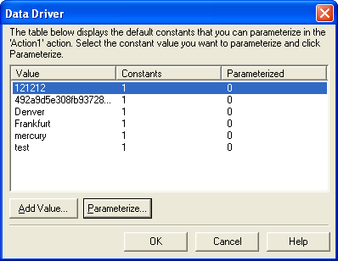
Data Table Parameters
Parameterizing Values
Data Table parameters enable you to create a data-driven test, component, or action that runs several times using the data you supply.
In each repetition, or iteration, QuickTest uses a different value from the Data Table.
When you create a new Data Table parameter, a new column is added in the Data Table and the current value you parameterized is placed in the first row.
To parameterize a value using the Data Driver:
1. Display the action you want to parameterize.
2. Choose Tools > Data Driver.

Slide 8
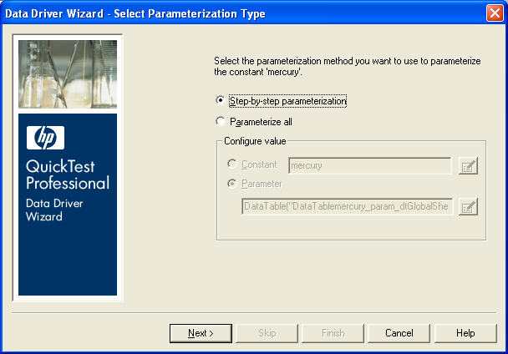
Data Table Parameters
Parameterizing Values
4. Select the value you want to parameterize from the Constants list and click Parameterize. The Data Driver Wizard opens.
5. Select the type of parameterization you want to perform:
Step-by-step parameterization
Parameterize all

Slide 9
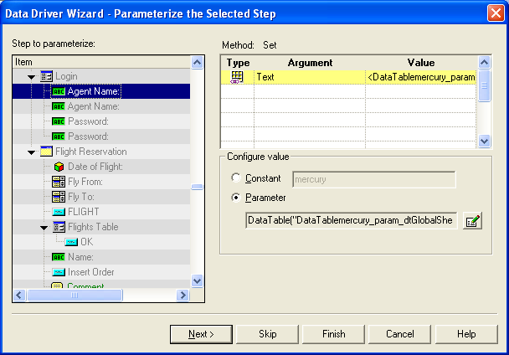
Data Table Parameters
Parameterizing Values
6. If you selected Parameterize all, the Parameter option is enabled in the Parameter details area. Select your parameterization preferences the same way that you would for an individual step.
If you selected Step-by-step parameterization, click Next. The Parameterize the Selected Step screen opens.
7. click the Parameter Options button to set the parameterization options you want to apply to this step. Click Finish.

Slide 10
Summary of the Topics Covered
Setting the Testing And Global options
Parameterization
Parameterization Benefits
Parameterization using Parameter utility
Data Table Parameters
Questions?

Slide 11

Thank You

